Slide 1
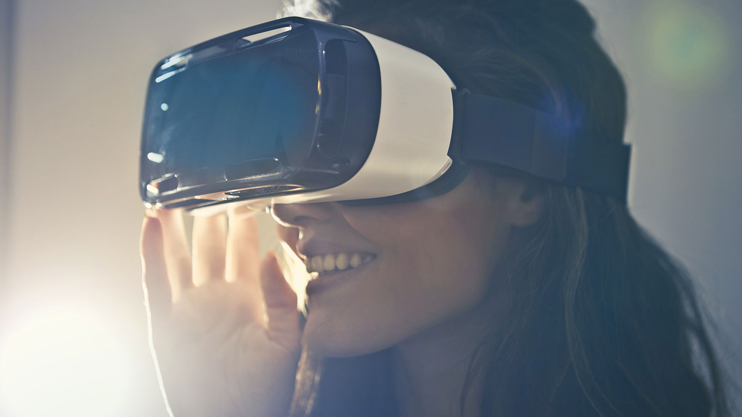
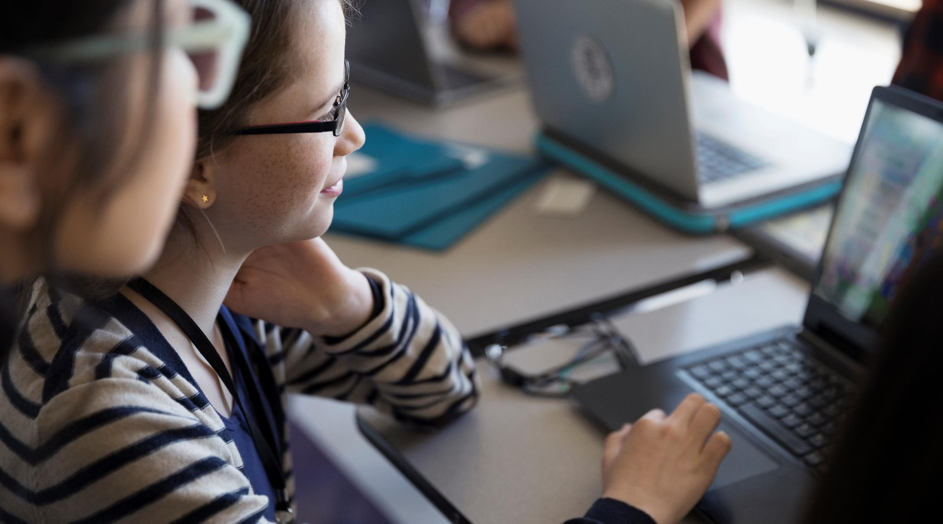
Rock, Paper & Scissor Recognizer
AI & Machine Learning
IBM PROJECT
BY-
ASUTOSH PATRA
& ANIMESH SINGH

Slide 2



TEAM
Animesh Singh
Asutosh Patra
Partner
Partner
Work on Gathering Data and Data processing.
Worked on Data handling, Data Visualization, Training the model with the processed data and find the final output.

Slide 3
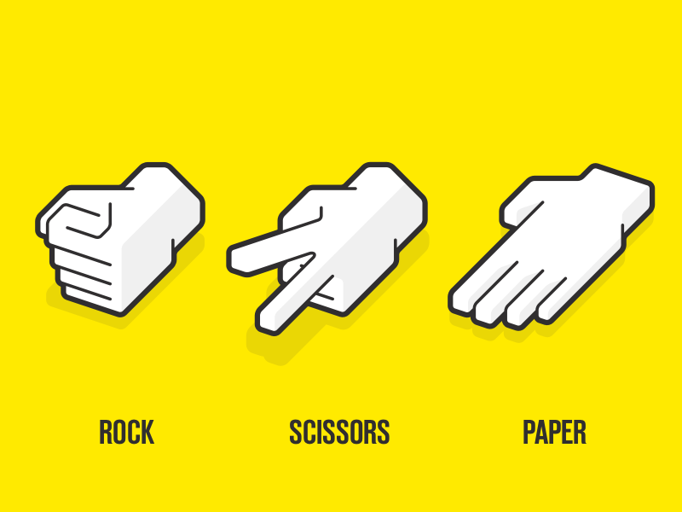
About Us
WHY THIS PROJECT?
We made this because it is very helpful for creating various games or object detection projects. So, we gathered some dataset sample from the user which is used to understand the gesture of the hand. Implemented a hand gesture recognition algorithm. Initially, the skin was segmented to separate it from the background. I have trained a model to recognize my hand signs when it is inside the box, so when the model predicts my hand signs. The application is designed in a way that the model can predict the gesture and calculate the proximate accuracy.
We are pursuing B.Tech CSE from Lovely Professional University, Punjab

Slide 4



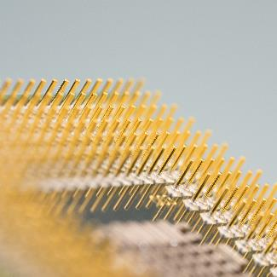

METHOD OF APPROACH TO SOLVE?
Data Collection
Data Processing
Built & Train Model
Checking
Testing
Gather Data, for Rock, Paper, Scissor Classes.
Preprocess Data and Split it.
Prepare Our Model for Transfer Learning & Train Our Model.
Check our Accuracy, Loss graphs & save the model.
Test on Live Webcam Feed.

Slide 5



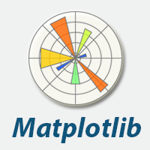

LIBRARIES USED
OpenCV
Tensorflow
Scikit Learn
Matplotlib
NumPy
OpenCV provides a real-time optimized Computer Vision library, tools, and hardware.
TensorFlow is an end-to-end open source platform for machine learning.
Simple and efficient tools for predictive data analysis
Matplotlib is a comprehensive library for creating static, animated, and interactive visualizations in Python.
NumPy brings the computational power of languages like C and Fortran to Python

Slide 6
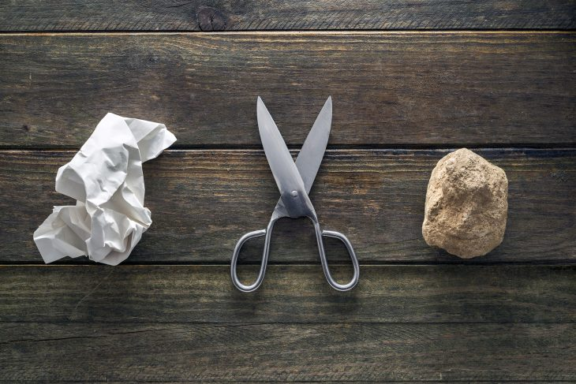
INTRODUCTION
The basis of this project was to experiment with Deep Learning and Image Classification with the aim of building a simple yet fun iteration of the infamous Rock Paper Scissors game.

Slide 7
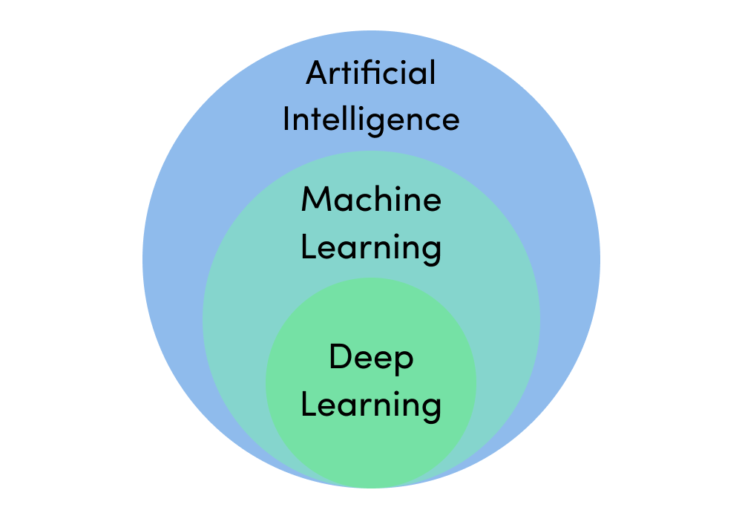

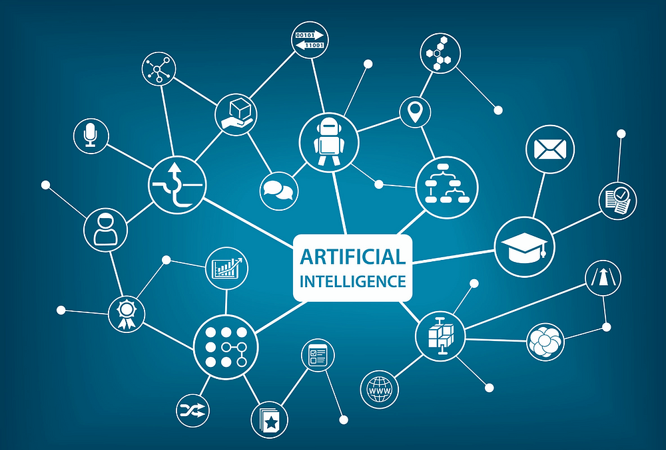
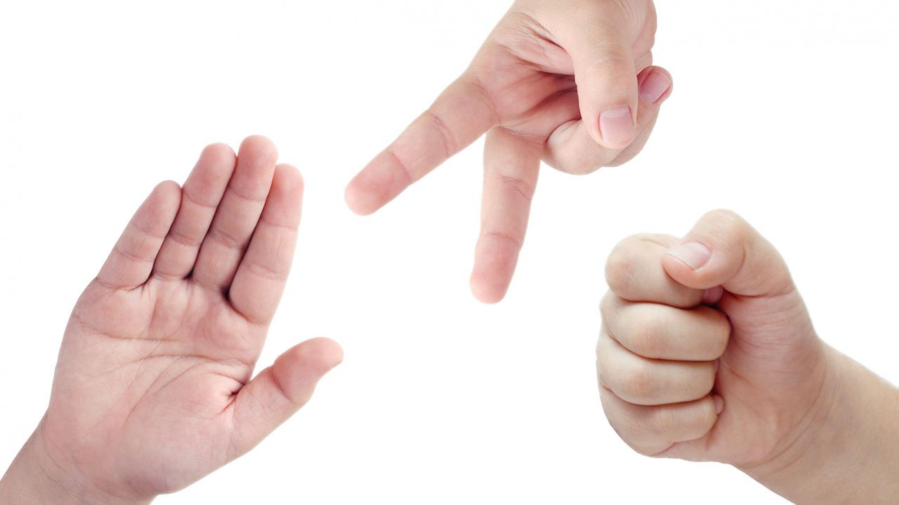
Deep Learning
Collecting and Processing Data
Building a Suitable AI Model
Deployment for Use
While building any sort of Deep Learning application there are 3 major steps

Slide 8
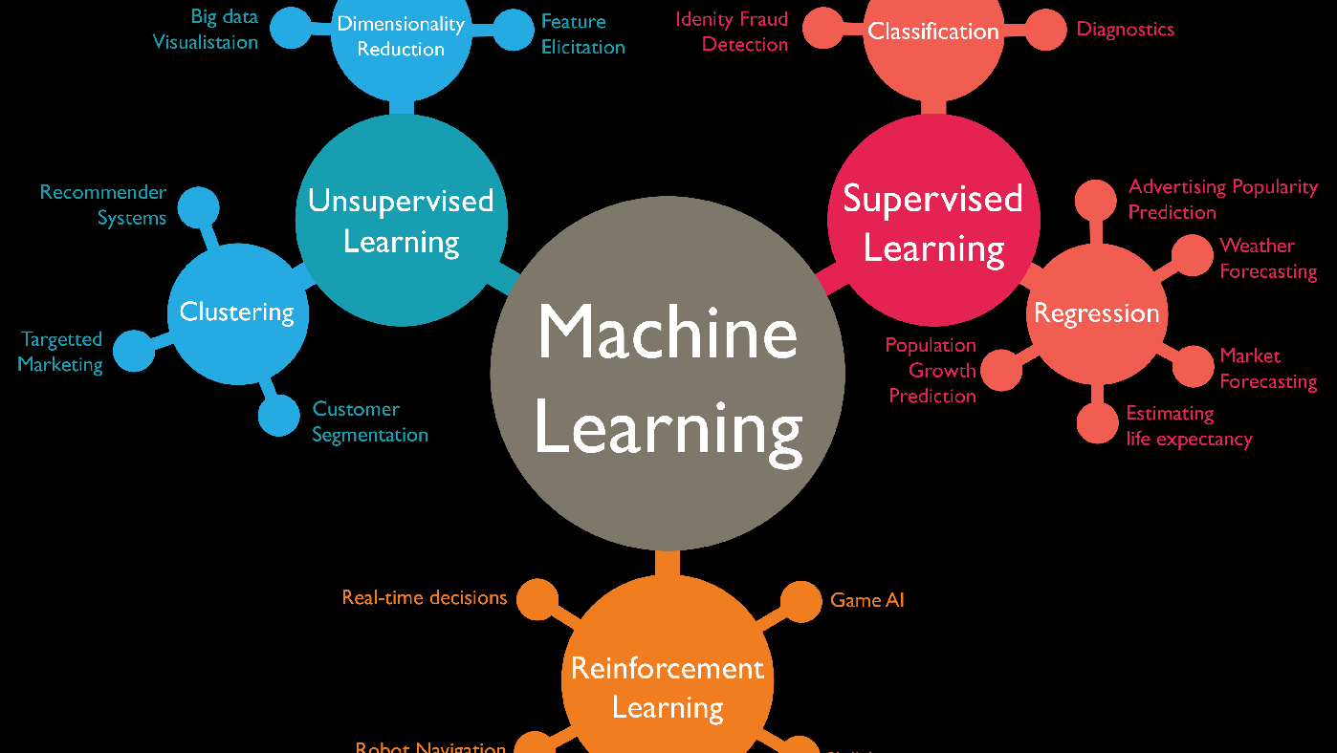
WHAT IS MACHINE LEARNING?
Machine learning is a branch of Artificial Intelligence (AI) and computer science which focuses on the use of data and algorithms to imitate the way that humans learn, gradually improving its accuracy

Slide 9
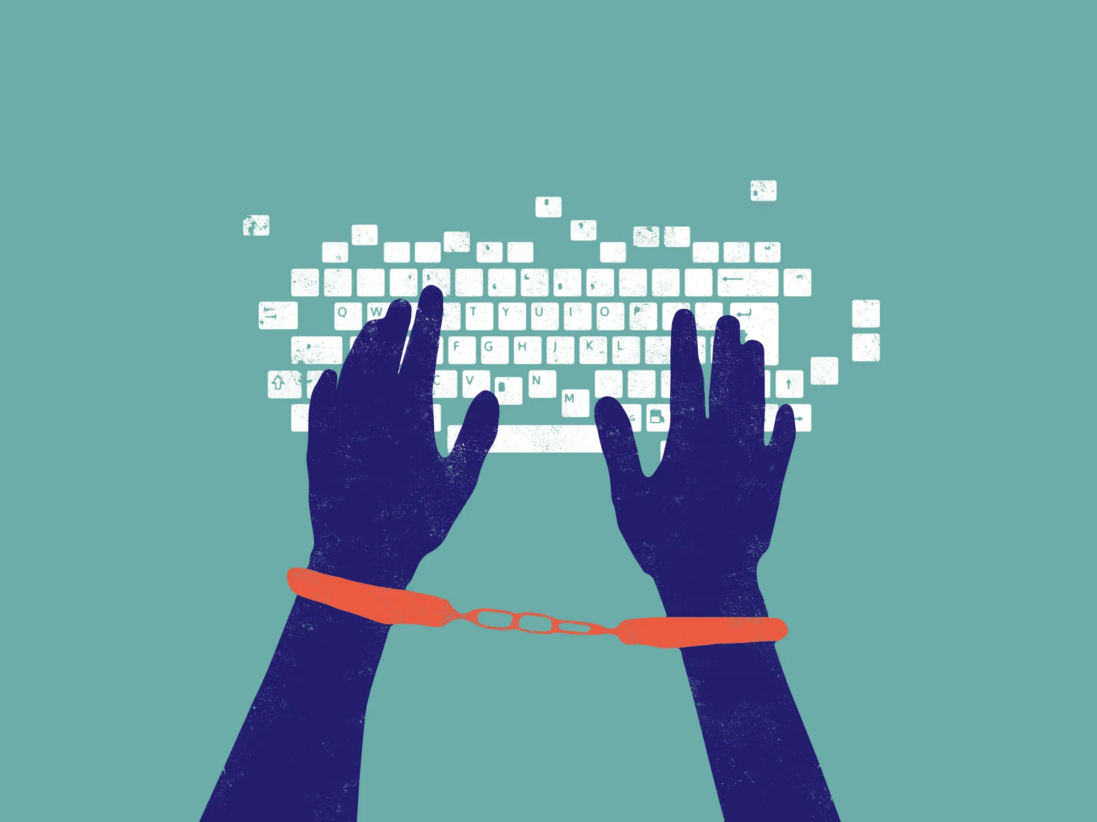
SOME GLIMPSES OF OUR CODE AND OUTPUT

Slide 10
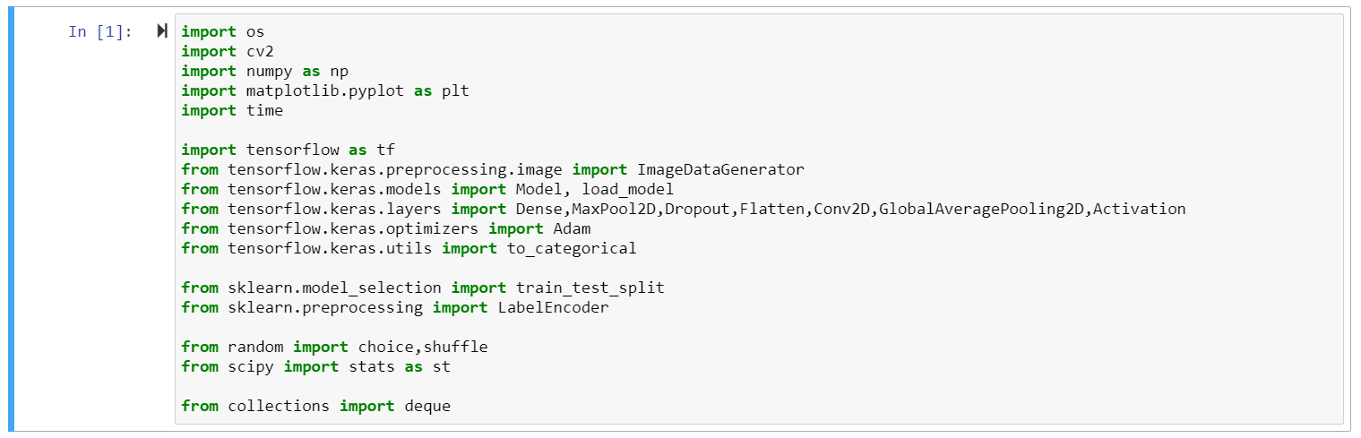

Slide 11
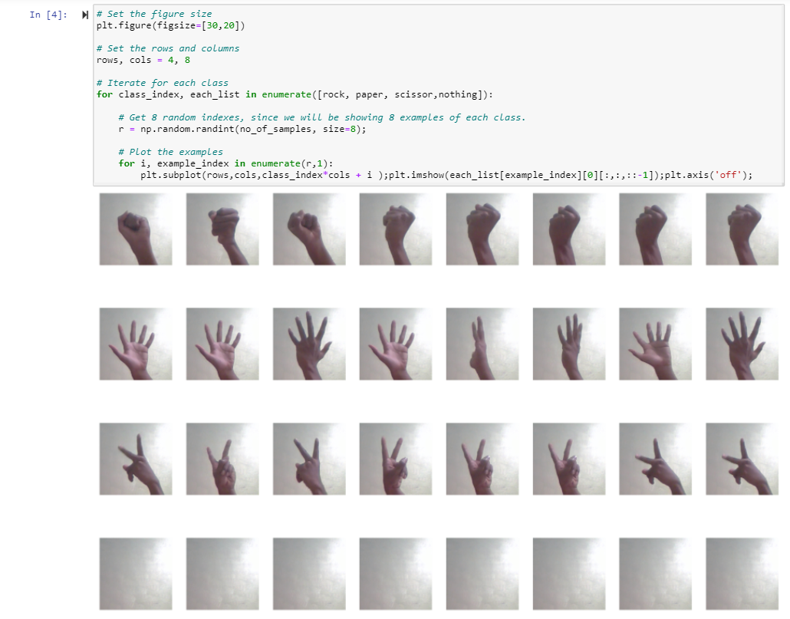

Slide 12
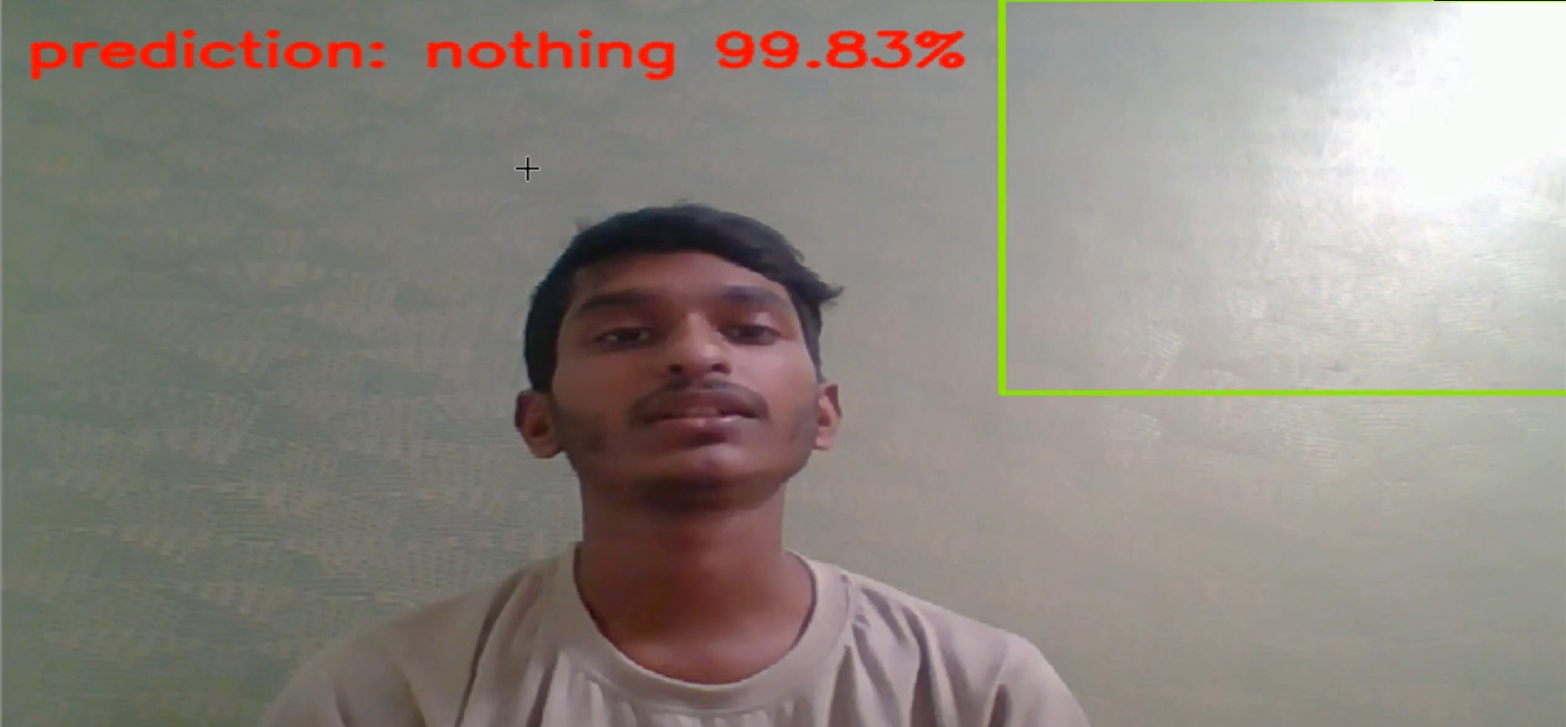

Slide 13
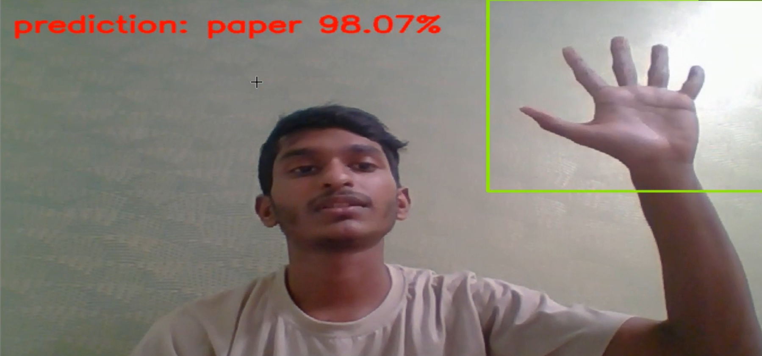

Slide 14
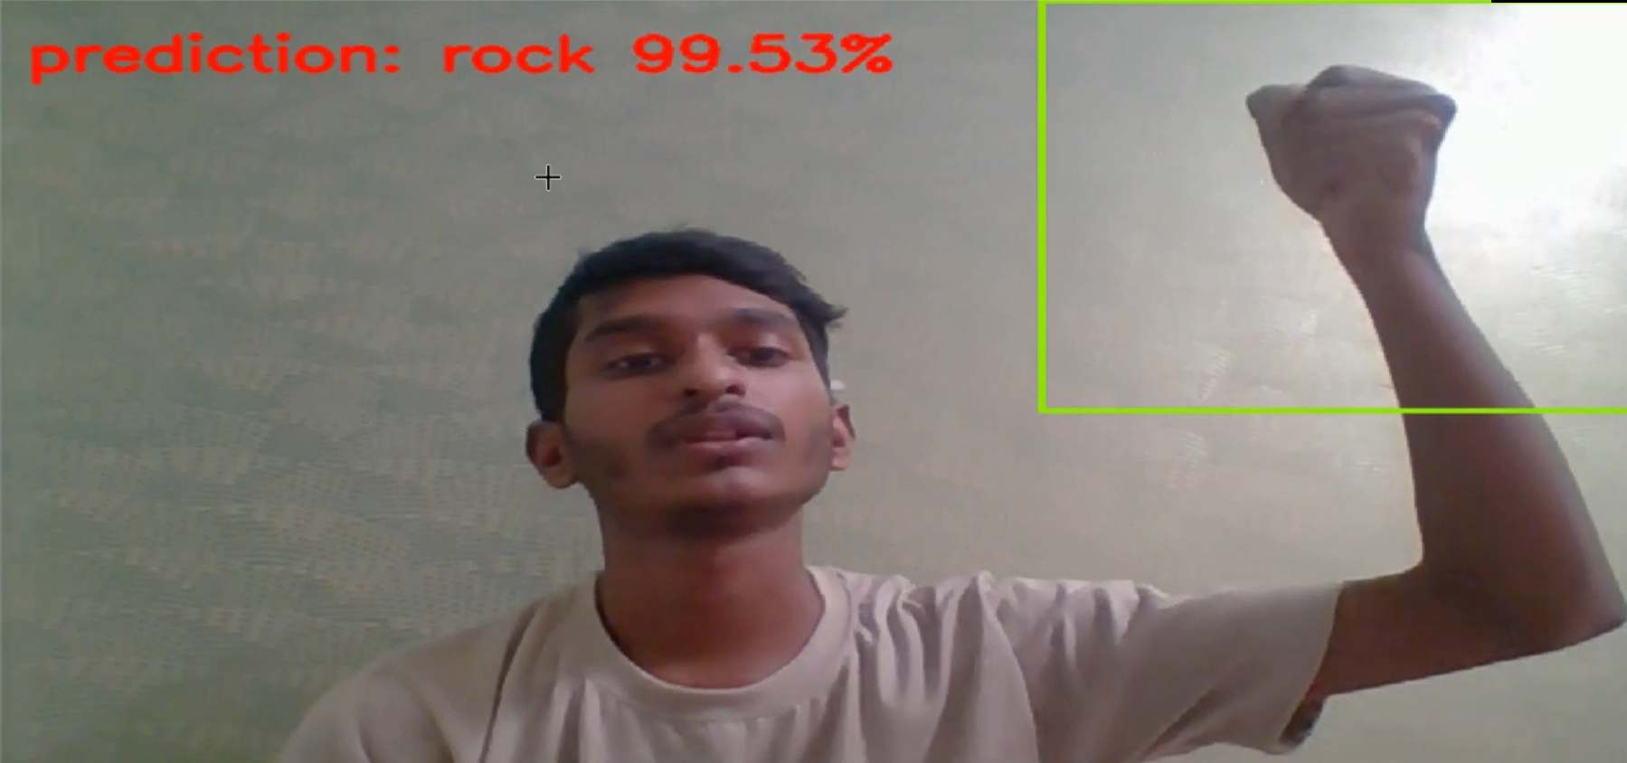

Slide 15
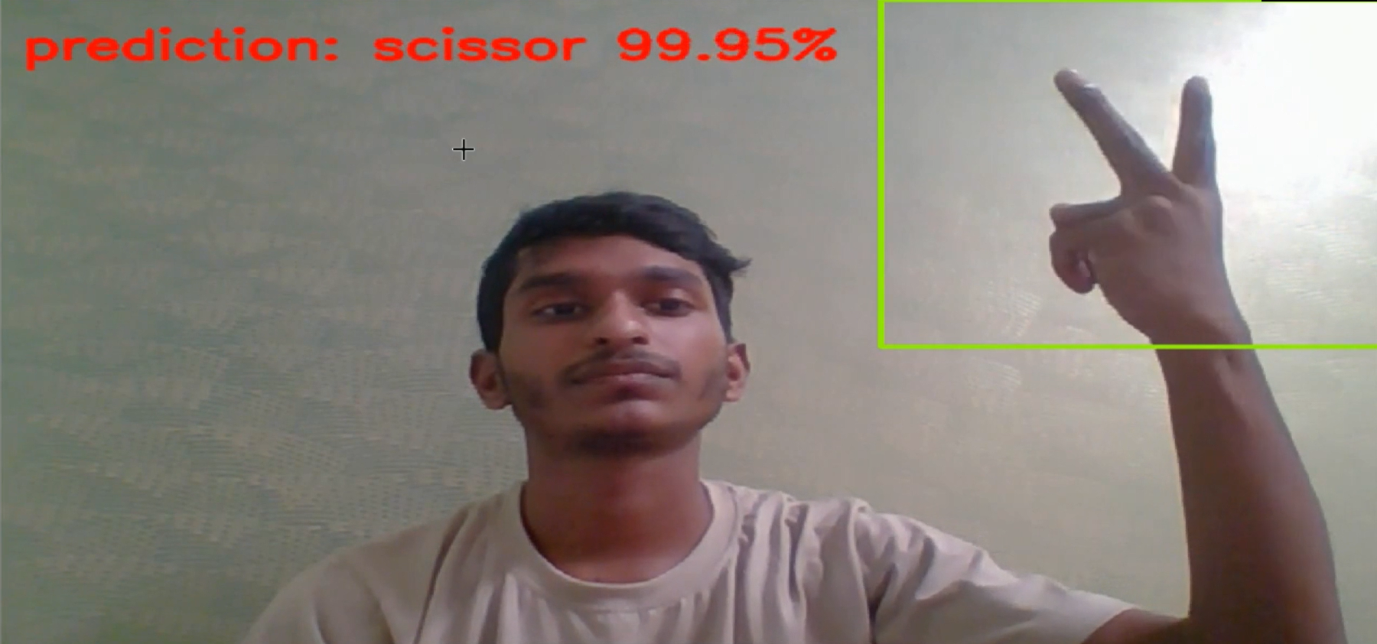

Slide 16
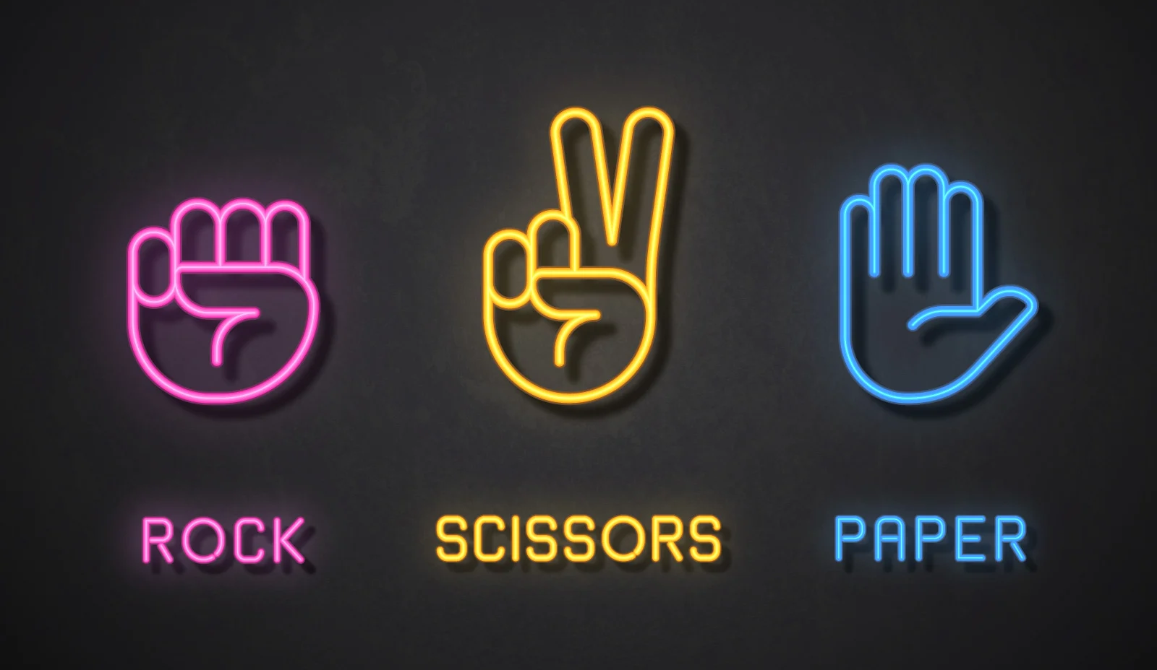
Conclusion
We’ve successfully implemented and understood the workings of this project. So go ahead and fork my implementation and experiment with it. A major improvement would probably be adding hand detection so we don’t need to explicitly draw a target zone and model would first detect hand position then make a prediction.

Slide 17
TESTIMONIAL
Learnt a lot of new things
It was a valuable learning experience
“
”
“
”
Asutosh Patra
Animesh Singh

Slide 18


Thank You
Asutosh Patra
Animesh Singh

